Slide 1
Cloud Introduction

Slide 2
Advance concept?
Earlier technology before that advance concept
Technology overview about that earlier concept
And how ait will work

Slide 3

Agenda
Advanced Concept – Cloud
From which base technology cloud is evolved?
Technical details about the concept which exist before the cloud?
How cloud is evolved from that?
Services they will offer?
Types?

Slide 4
Cloud computing is the on-demand availability of computer system resources, especially data storage and computing power, without direct active management by the user. The term is generally used to describe data centers available to many users over the Internet.
Compute ->

Slide 5
Charles Babbage
1980 -> calculation -> abacus
Did any company claims that we invented the computer?

Slide 6
Computing means the data processing from one state to another state.
Data as input, get the as output.
Data volume is huge, output is less.
Computing Components -> Processor + RAM + Storage + I/O + SMPS
BIOS -> ensure that all the microcontrollers got the power supply
POST -> Power on SELF Test -> it will check for all the devices that will run the computer are working perfectly

Slide 7
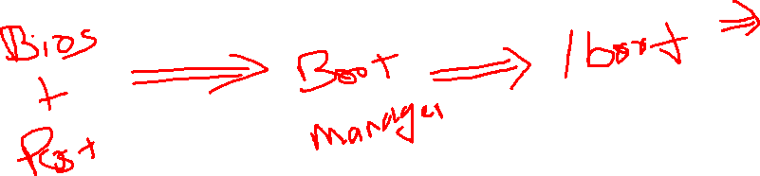
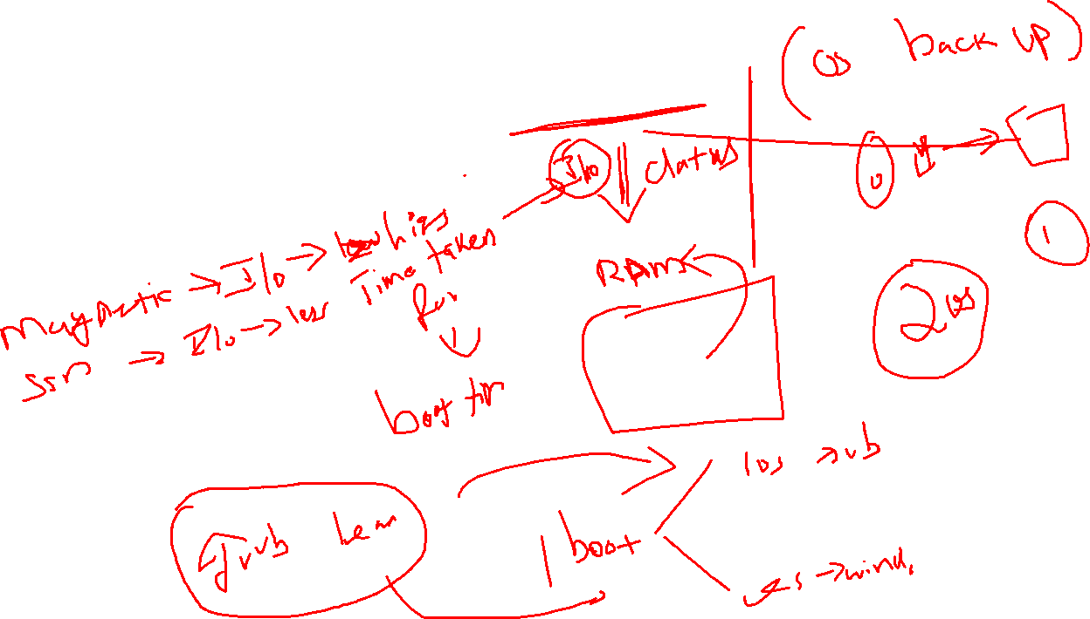

Slide 8
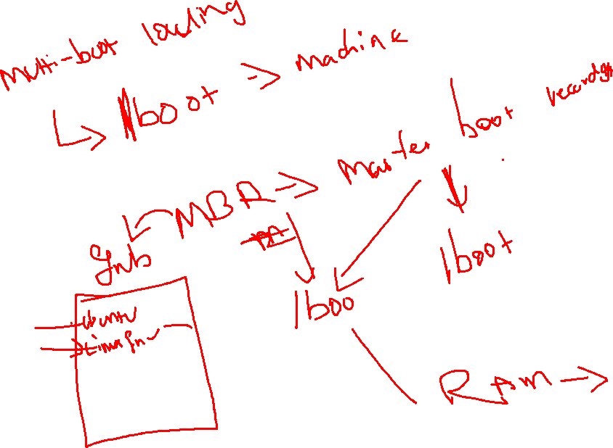

Slide 9
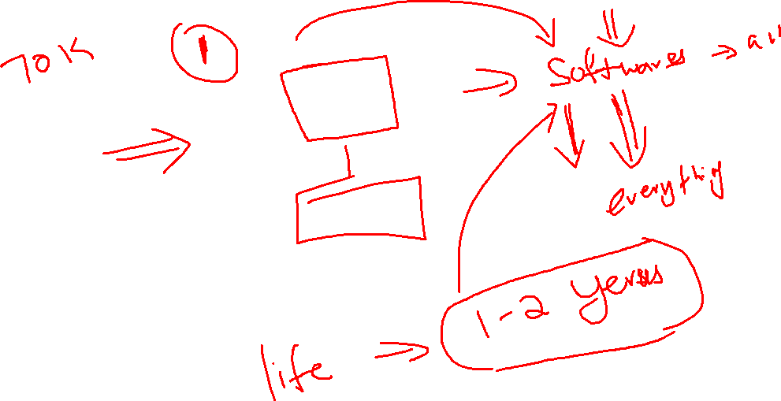

Slide 10
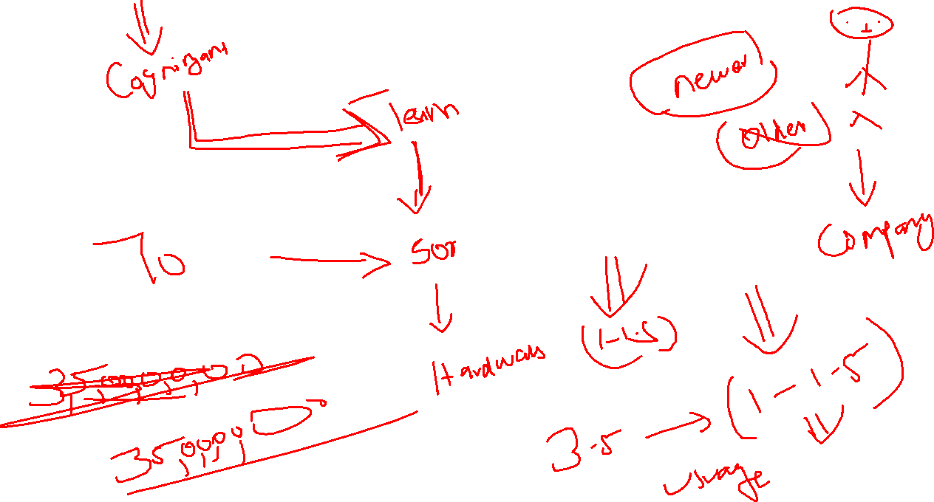

Slide 11
2005
Life time –> 12-16 Months
500 Member -> 3.5 Crore
21,87,500 per month -> hardware
Dedicated Machines

Slide 12
Virtualization
We can install multiple OS at the same hardware and can able to run all at once
2 types
Type 1
Type 2

Slide 13
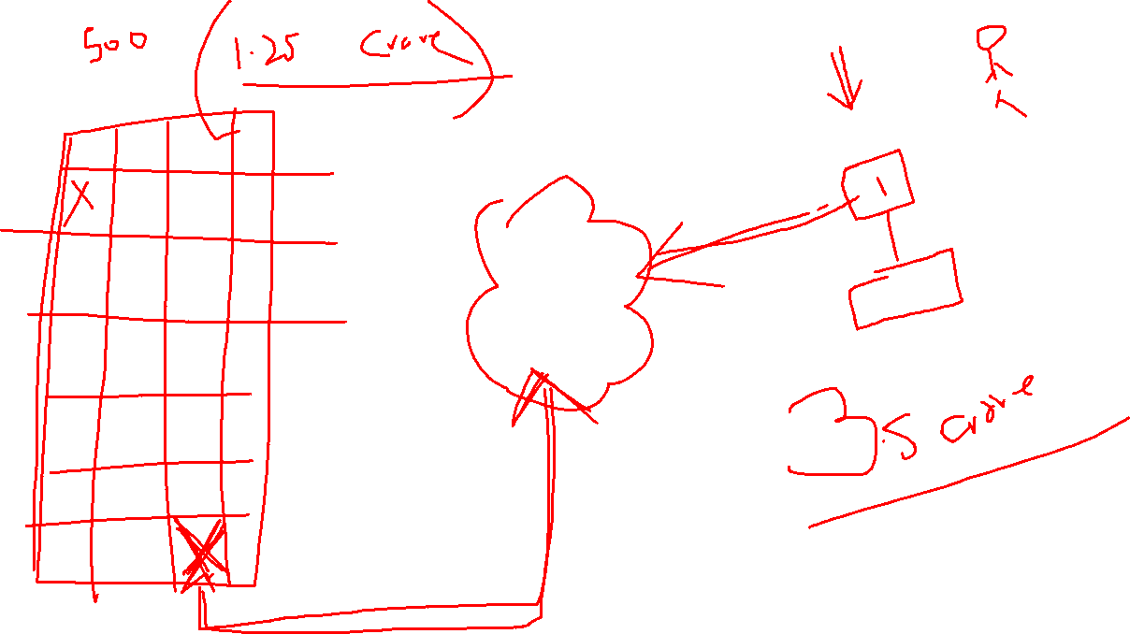

Slide 14
Virtualization
The concept of creating the fake environment to make the OS to trust the virtual environment and let the OS to run
BIOS + POST + BOOT MGR + Boot Sector
Save the Cost
Hardware
Maintainence

Slide 15
Types of Virtualization
Type 1 -> we are going to install the virtualization software(Hypervisor) as Application layer software and on top of the Application layer we will install the OS
Type 2 -> we are going to install the virtualization software(Hypervisor) as OS and top of that OS we manage to deploy Multiple OS in it

Slide 16
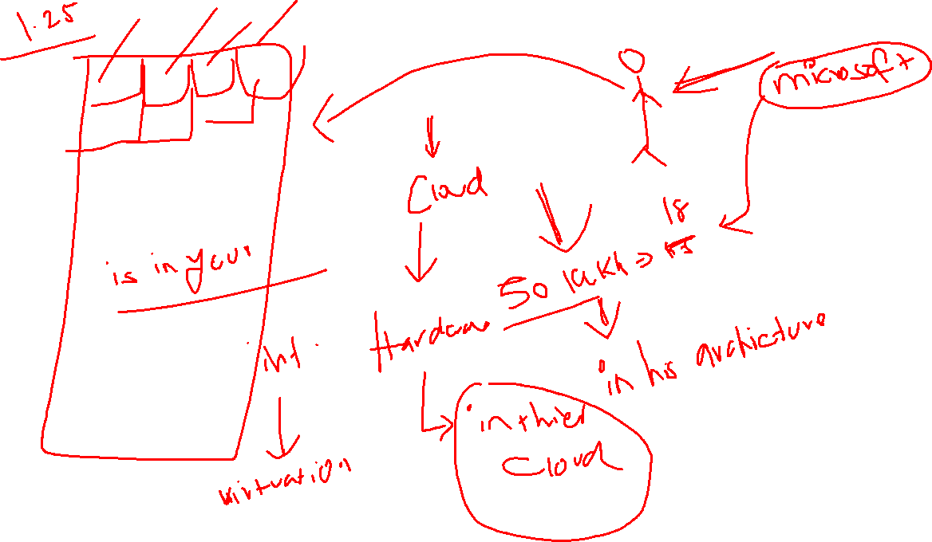

Slide 17
Types of Cloud
Public
Private
Hybrid
Community+

Slide 19
Services offered by cloud
Plan to deploy your architecture in cloud means
IAAS -> take the rental of only the hardware and OS -> your responsibility(Firewall, Security)
SAAS -> software as rental
PAAS -> platform as the service -> end

Slide 20
